Slide 1

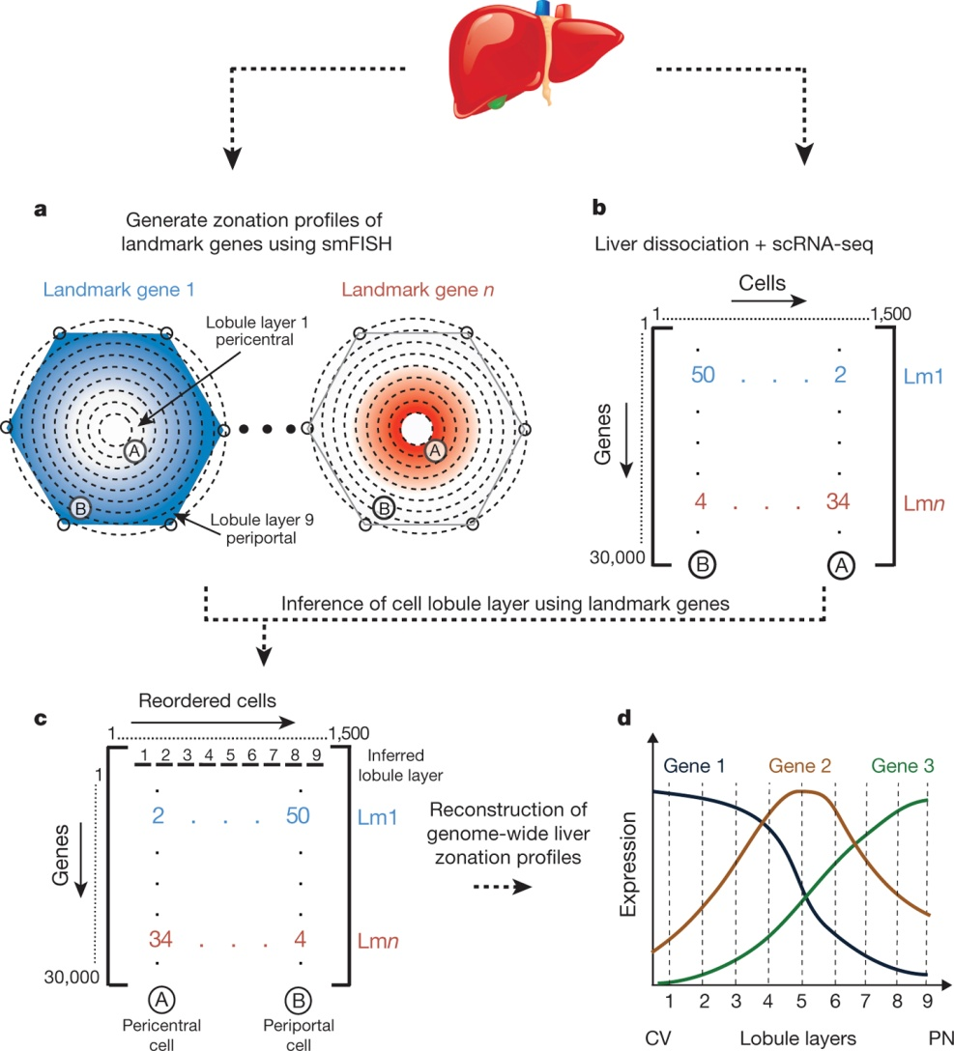
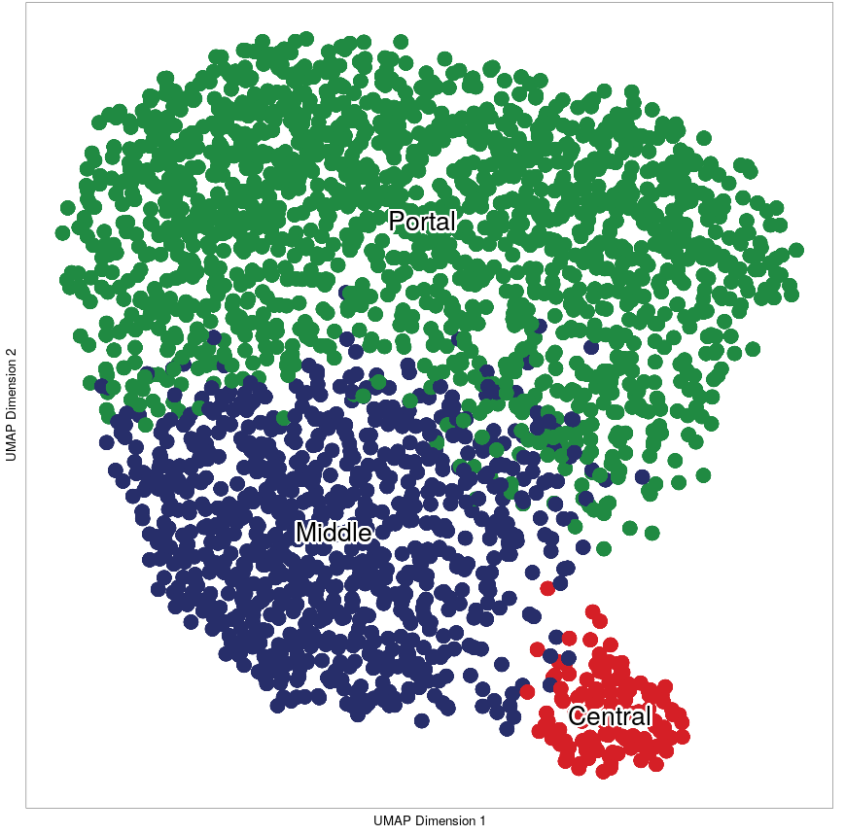
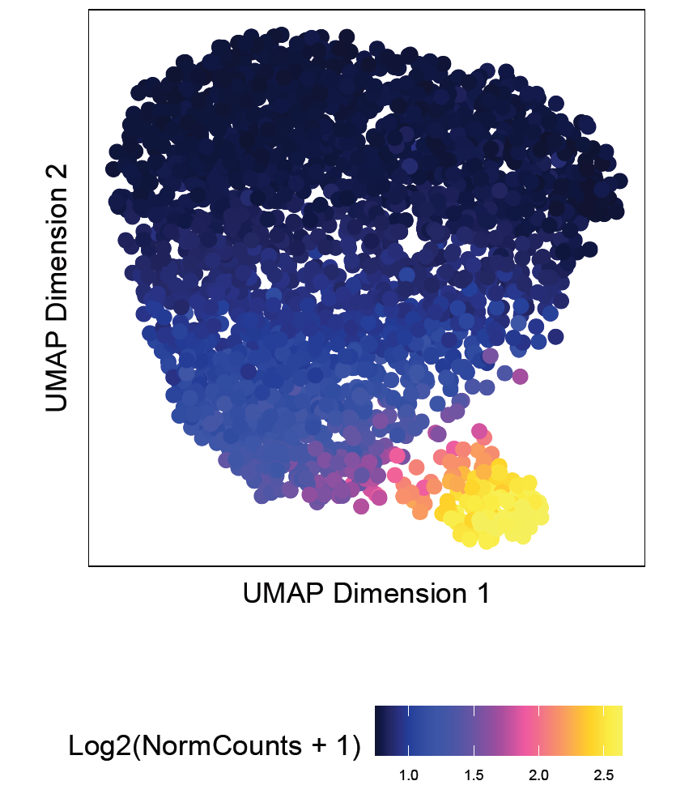
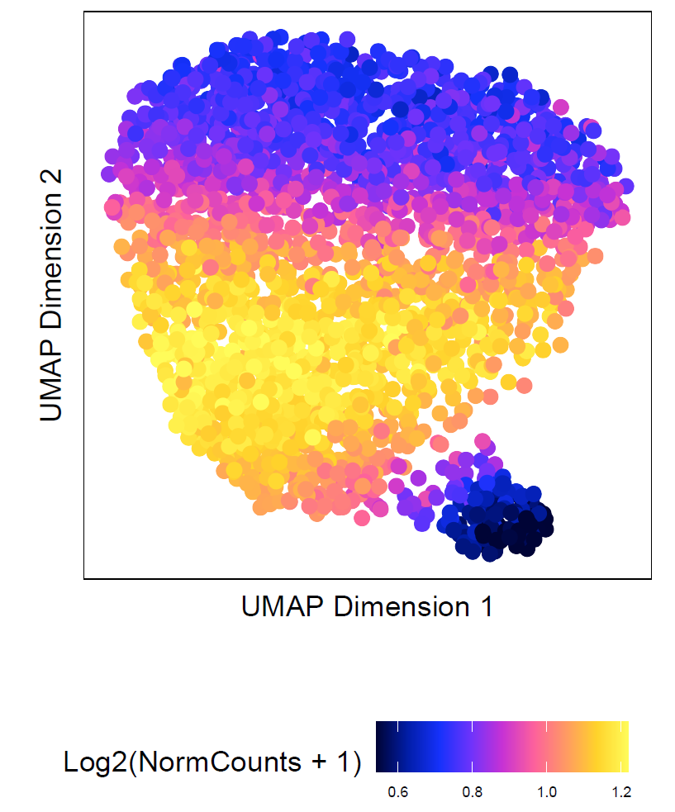
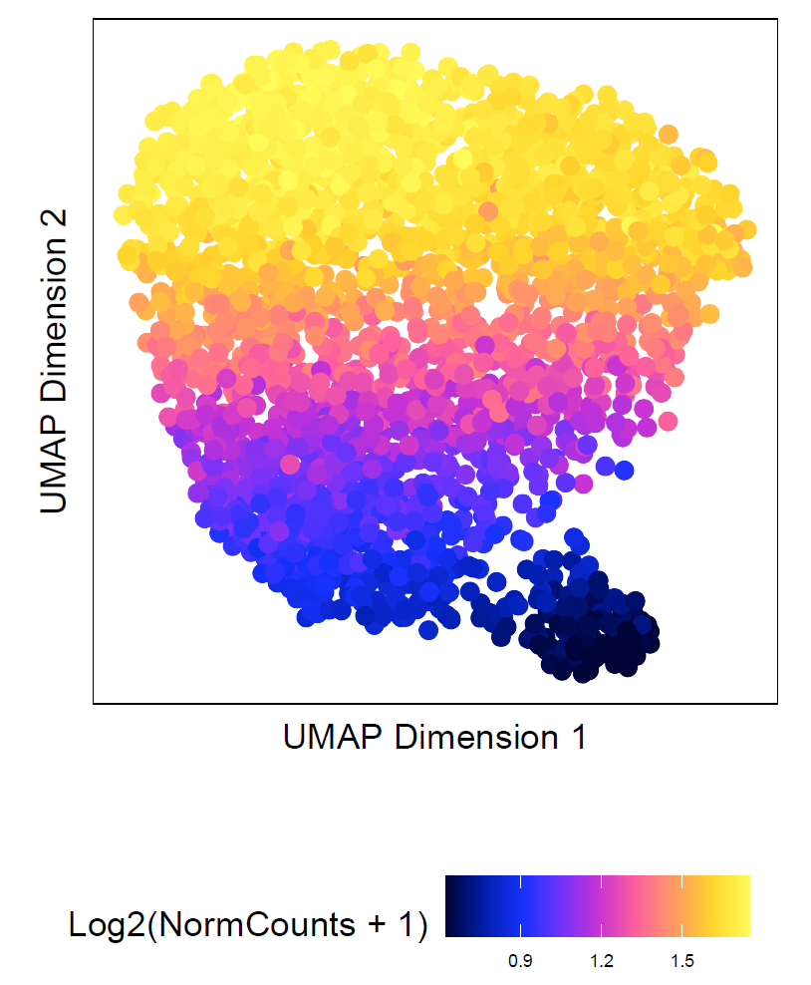
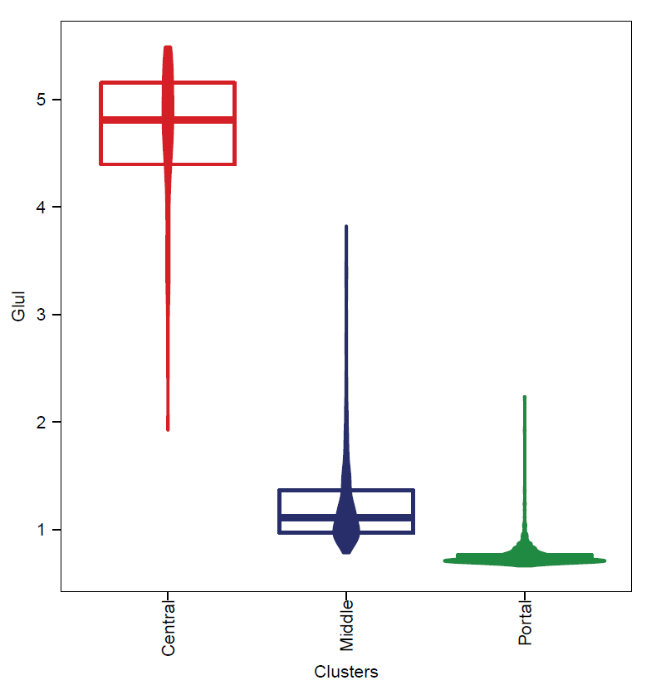
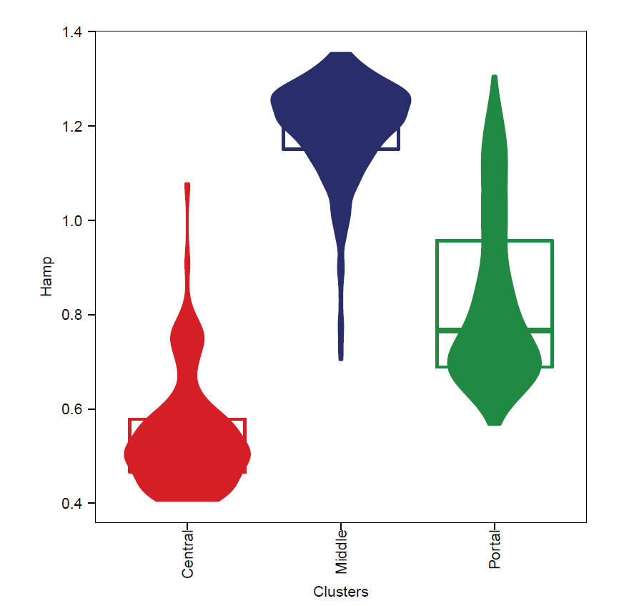
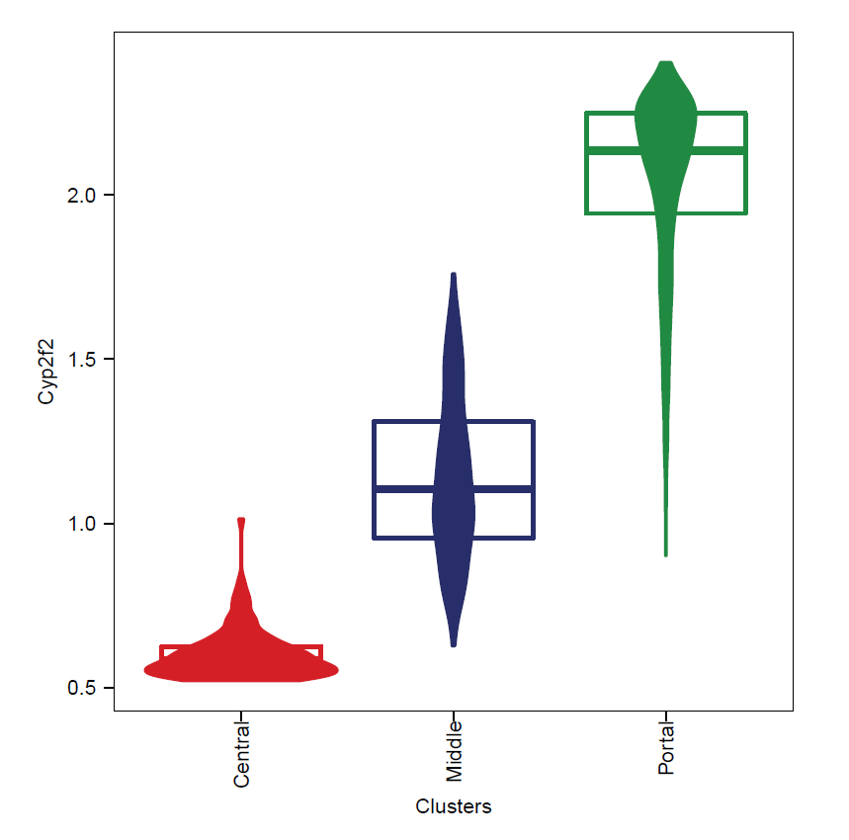
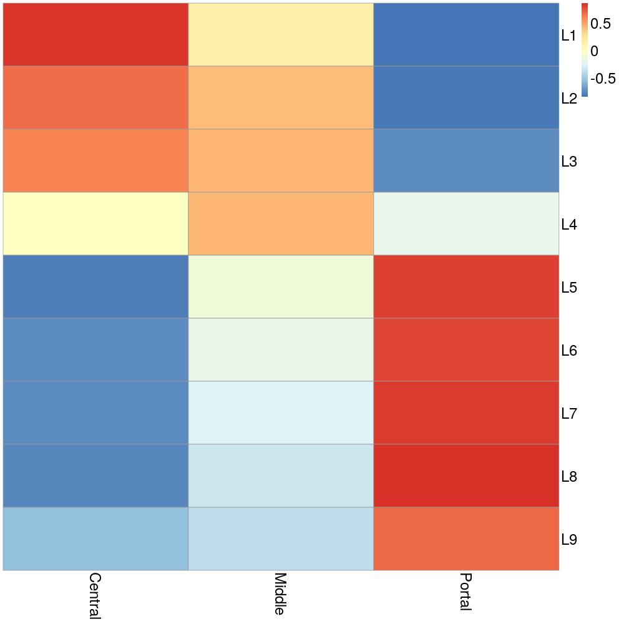
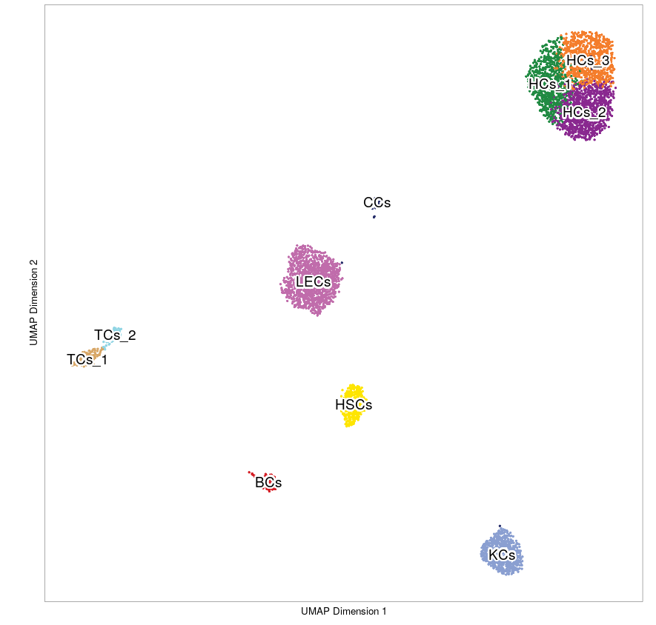
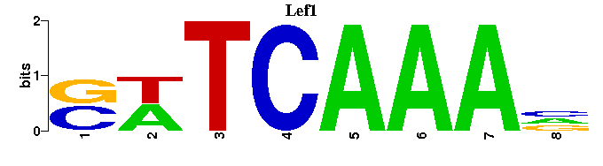
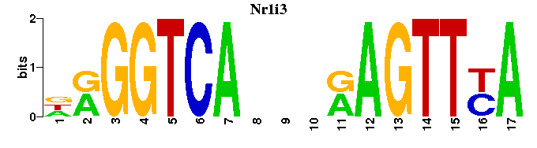
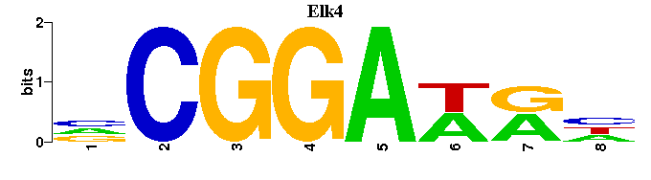
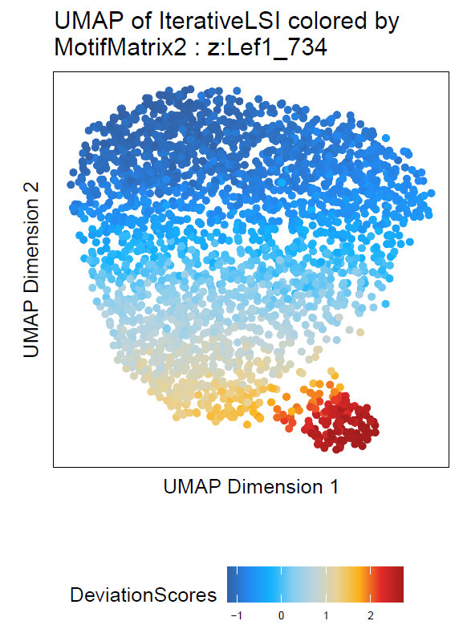
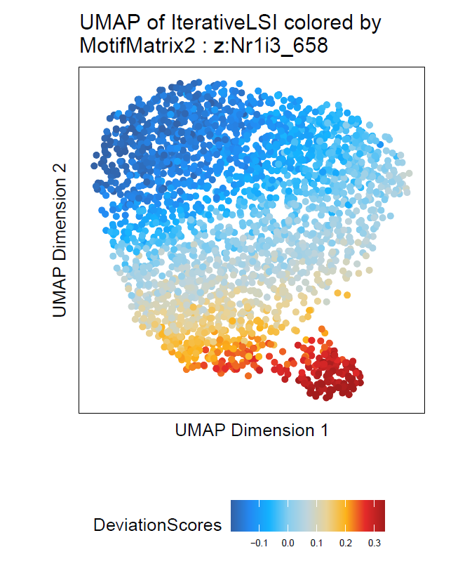
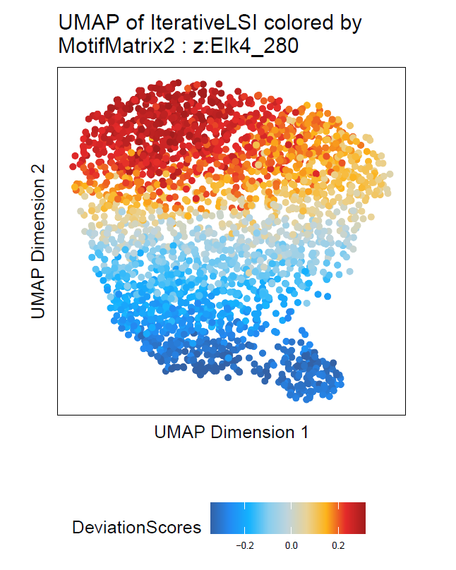
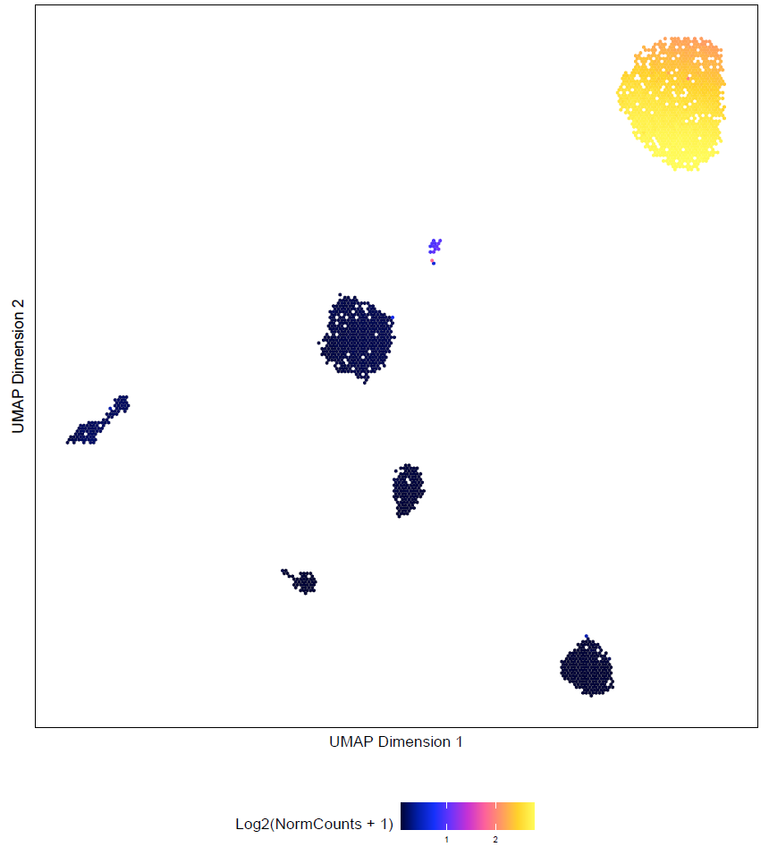
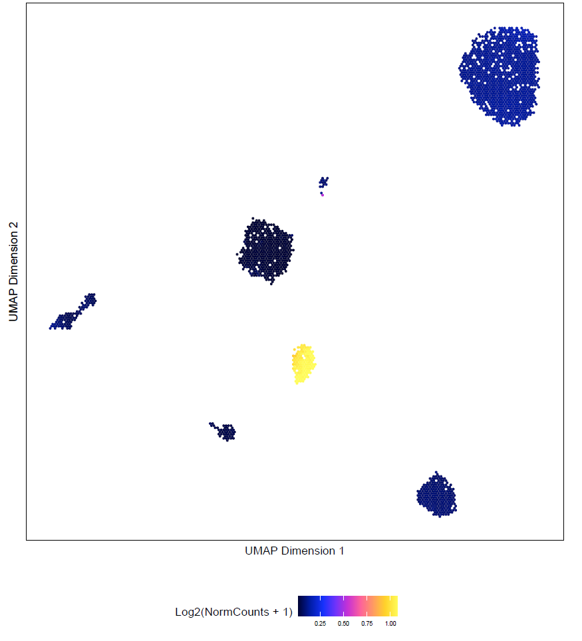
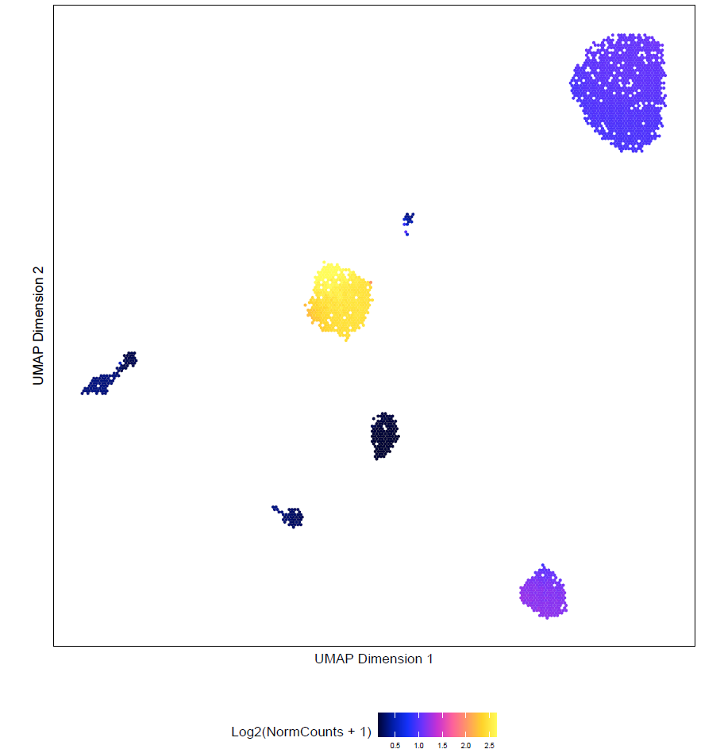
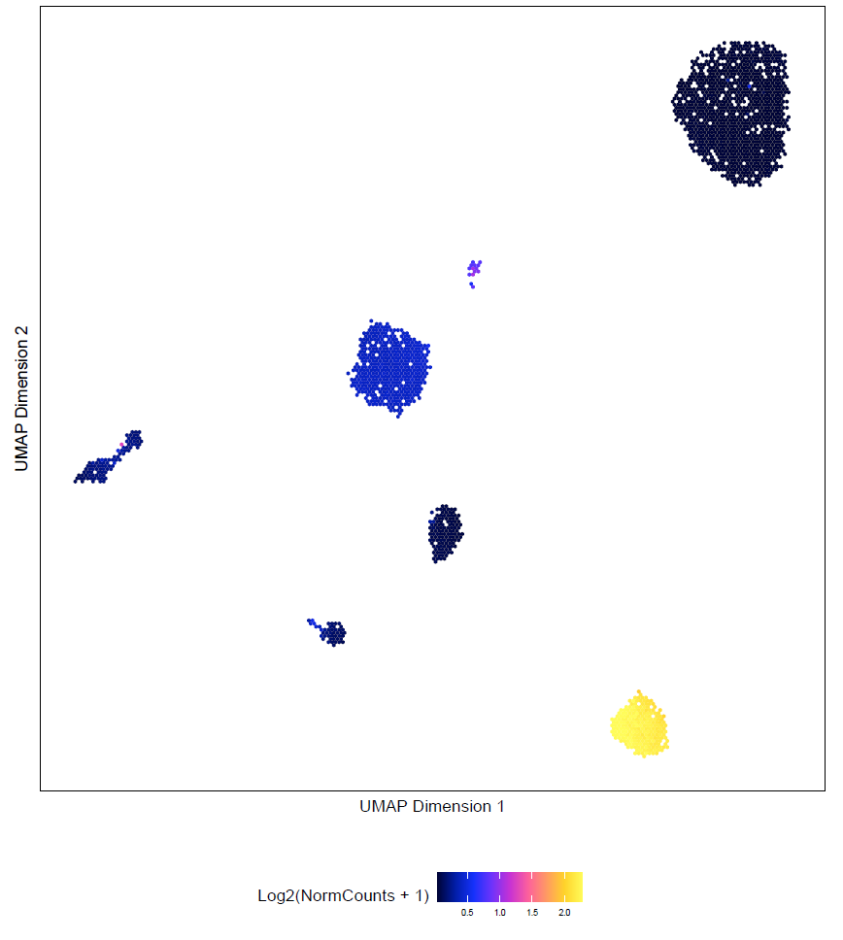
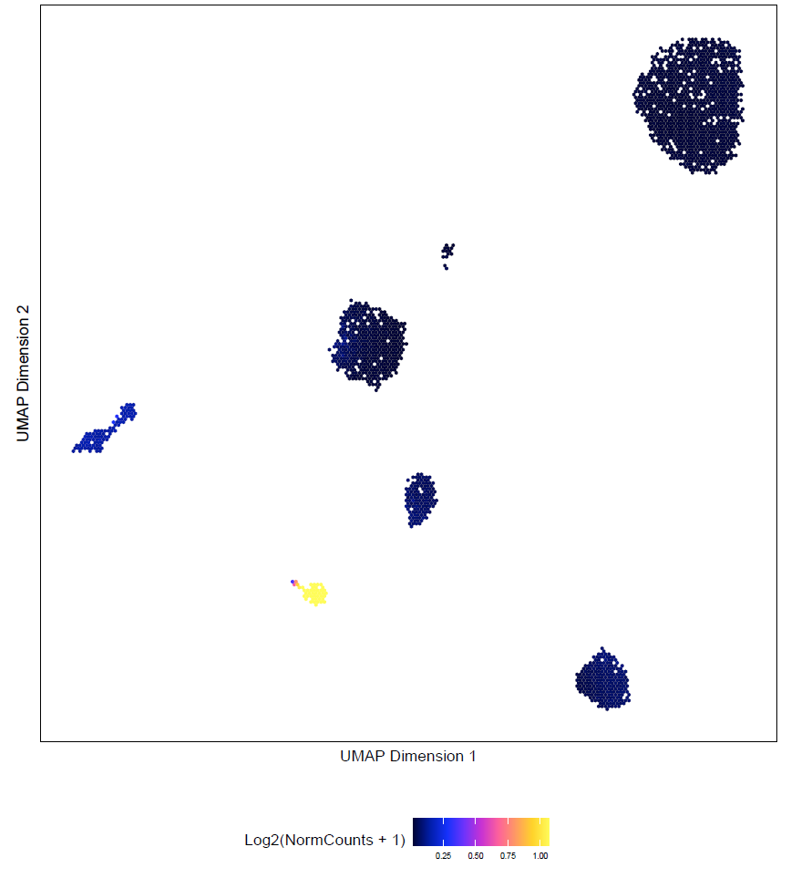
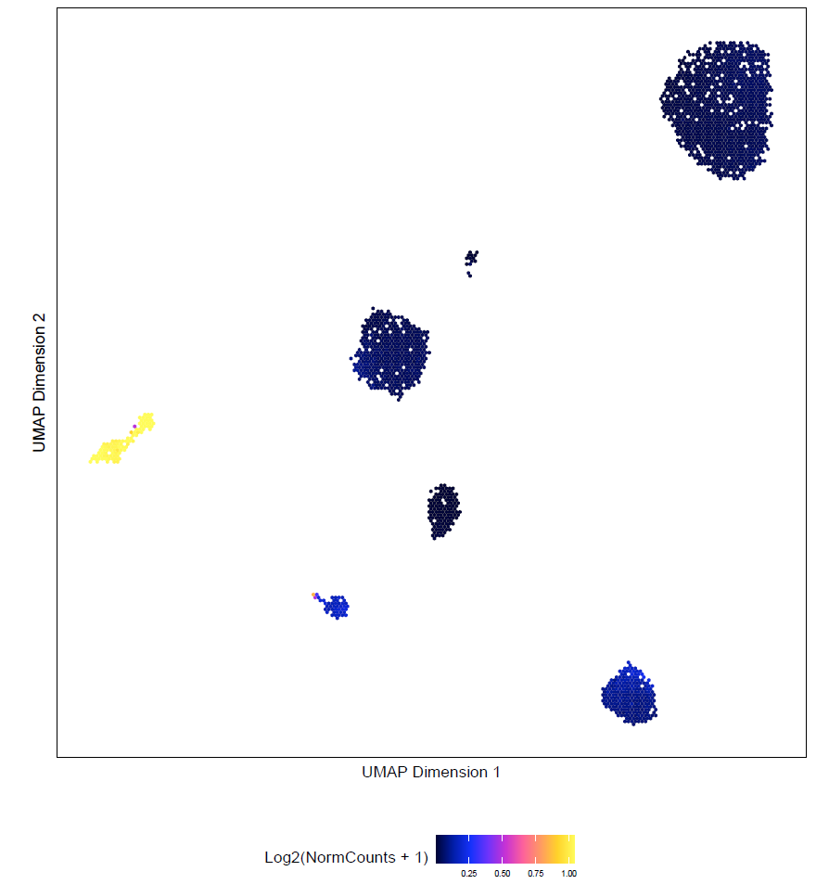





Transcriptional regulation of hepatocyte heterogeneity Nicolaj Ibsgaard Toft^{1,2}, Trine V. Dam^{1,2}, Fabio Avolio^{1,2}, Lars Grøntved^{1,2}
¹Center for Functional Genomics and Tissue Plasticity (ATLAS), Department of Biochemistry and Molecular Biology, University of Southern Denmark, Odense, Denmark ²Functional Genomics and Metabolism Research Unit, Department of Biochemistry and Molecular Biology, University of Southern Denmark, Odense, Denmark.
Background and aim
Hepatocytes cluster according to zonation
1
3
Liver tissue is spatially organized with hepatocytes placed in repeating lobules. Hepatocytes exhibit sub-specialization dependent on spatial position within a lobule, referred to as zonation [1]. Halpern et al combined single cell transcriptomics with imaging techniques to reconstruct genome-wide liver zonation profiles and found 50% of hepatic genes to be expressed in a zonated manner [2]. Several pathways have been shown to be zonated, however, less is known about the transcriptional regulation driving sub-specialization of hepatocytes.
We aim to gain insights into the transcriptional regulation of hepatocyte zonation by profiling chromatin accessibility at single nucleus level in healthy livers, and utilizing the transcriptomic genome-wide liver zonation profiles constructed by Halpern et al.
A Hepatocytes exhibit heterogeneity B Hepatocyte clusters display differential in chromatin accessibility accessibility in zonation marker genes
Glul
Hamp
Cyp2f2
Log2(NormCount + 1)
Fraction of mean
Workflow from Halpern et al. Combining spatial imaging of zonation markers and utilizing these patterns for predicting cell localization based on scRNA-seq allowed to reconstuct genome-wide liver zonation profiles. Modified from [2].
C
P
C
P
C
P
C Correlation of hepatocyte clusters with zonated transcriptional profiles
Single nucleus chromatin accessibility profiles of hepatocytes recapitulate transcriptional zonation. A) Reclustering of hepatocytes reveal hepatocyte heterogeneity as distinct clusters is formed. These clusters were manually annotated to different lobule zones based on several zonation markers (see B for examples). B) Examples of zonation marker genes used for annotation of the hepatocyte clusters. Upper panel depicts chromatin accessibility in individual nuclei. Middle panel is violin plots depicting chromatin accessibility in the given zonation markers for each cluster. The lower panel display the expression of the given marker as fraction of mean for 9 different lobule layers (data from [2]). C) Pearson correlation between chromatin accessibility in the different hepatocyte clusters found here and the gene expression of each lobule layer reported by Halpern et al. The correlation was based on the 95 most significantly zonated genes in [2]. Chromatin accessibility and gene expression was z-score normalized across the clusters and layers, respectively, before correlation. Layer 1 (L1) is the most central layer and L9 is the most portal layer. C:Central, P:Portal.
C
The major hepatic cell types are identified
2
Ba
A The major hepatic cell types are identified B Distribution of hepatic cell types
HCs: Hepatocytes
HSCs: Hepatic stellate cells
LECs: Liver endothelial cells
KCs: Kupffer cells
CCs: Cholangiocytes
BCs: B cells
TCs: T cells
P
4 Motifs downstream of zonated pathways exhibit zonated accessibility
Lef1
Nr1i3
Elk4
Motifs of transcription factors downstream of known zonated pathways reveal zonated patterns of chromatin accessibility. Lef1 is downstream of Wnt signaling. Nr1i3 is involved in xenobiotic metabolism. Elk4 is downstream of Ras signaling. The mentioned pathways have been shown to be zonated [2]. For each factor the motif and deviation score per nucleus is shown. Deviation score is a measurement of how far the accessibility in a given nucleus deviates from the average of all nuclei. Thus, profiling chromatin accessibility at single nucleus resolution reveal zonated transcription factors.
C Chromatin accessibility in cell type specific marker genes
Alb
Lrat
Stab2
Conclusion and perspectives
5
We identify the major hepatic cell types by performing snATAC-seq on nuclei isolated from frozen murine liver.
Hepatocytes were heterogenous and displayed differential chromatin accessibility in zonatation markers, recapitulating transcriptional zonation.
We were able to detect zonated motif accessibility profiles of transcription factors downstream of zonated pathways.
Increasing sample size (currently n=1) and integrating scRNA-seq will enable identification of gene regulatory networks driving zonation.
Clec4f
Cd19
Cd3g
Identification and distribution of hepatic cell types in healthy mouse liver. hepatic nuclei isolated from frozsen livers of 8-week-old mice (n=1) fed a normal chow diet were analyzed by snATAC-seq to obtain chromatin accessibility profiles of each individual nucleus. A) Profiled hepatic nuclei clustered based on chromatin accessibility profile; thus, distinct cell types form distinct clusters. Clusters were annotated manually based on their chromatin accessibility in specific cell type marker genes (see C for examples). Colors indicate the cluster assigned to a given nucleus. B) Percentage distribution between different cell types. Sub-clusters of each major cell type was collapsed to one cluster. C) Chromatin accessibility in cell type specific marker genes for each nucleus. These are examples of some marker genes used to manually annotate the clusters in A.
Contact Nicolaj Ibsgaard Toft:
Nicolajit@bmb.sdu.dk Lars Grøntved: larsgr@bmb.sdu.dk
Acknowledgement This research was funded by the Danish National Research Foundation.
.
References
Gebhardt, R. Metabolic zonation of the liver: regulation and implications for liver function. Pharmacol. Ther . 53, 275–354 (1992)
Halpern KB, et al. Single-cell spatial reconstruction reveals global division of labour in the mammalian liver. Nature. 2017;542(7641):352–356

